Slide 1

Enterprise Integration Framework

Slide 2
Agenda
What is Apache Camel?
Enterprise Integration Patterns
What's in the Camel box?
Riding Camel
Deploying Camel
Q & A

Slide 3
What is Apache Camel?
Concise Application Message Exchange Language
Apache Camel is a versatile open-source integration framework that is based on known Enterprise Integration Patterns which allows your applications to accomplish intelligent routing, message transformation and protocol mediation in a variety of domain-specific languages Java DSL, Spring XML, Groovy DSL and Scala DSL.
Why do we need integration?
Critical for your business to integrate
Why Integration Framework?
Framework do the heavy lifting
You can focus on business problem
Not "reinventing the wheel"
http://camel.apache.org/why-the-name-camel.html

Slide 4
Enterprise Integration Patterns
65 EIP Patterns
EIP Book
http://www.enterpriseintegrationpatterns.com

Slide 5
Common EIP Patterns

Slide 6
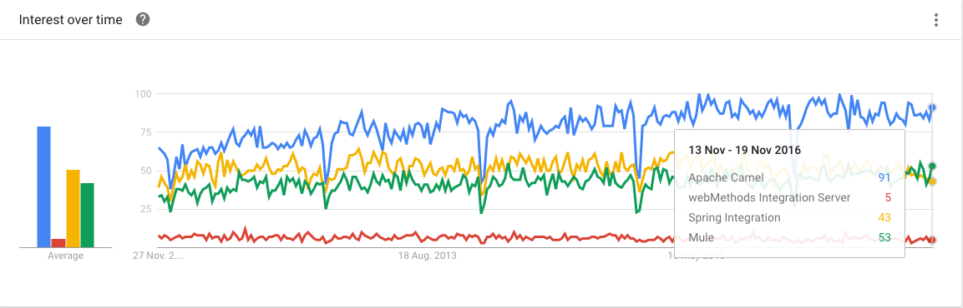
Why use Camel ?
■ Routing and mediation engine ■ Enterprise integration patterns (EIPs)
■ Domain-specific language (DSL) ■ Extensive component library
■ Payload-agnostic router ■ Modular and pluggable architecture
■ POJO model ■ Easy configuration
■ Automatic type converters ■ Lightweight core
■ Test kit ■ Vibrant community
https://www.google.co.in/trends/

Slide 7
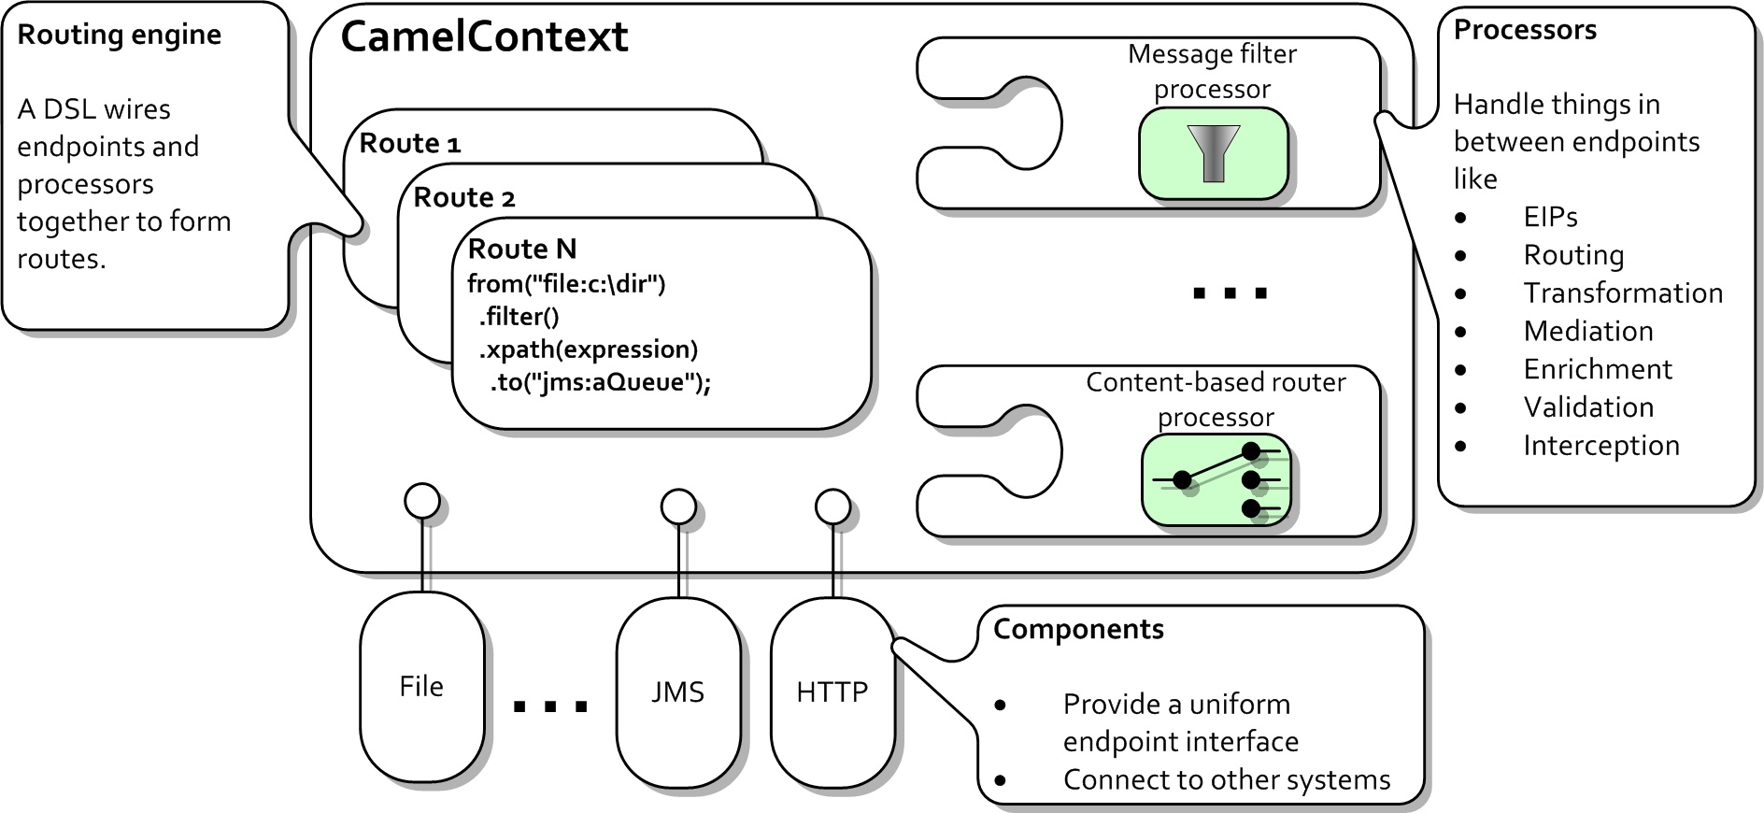
Camel's Architecture

Slide 8
Riding Camel
File Copier
Java DSL
Camel XML DSL
<camelContext id="camel" xmlns="http://camel.apache.org/schema/spring">
<route>
<from uri="file:data/inbox?noop=true"/>
<to uri="file:data/outbox">
</route>
</camelContext>

Slide 9
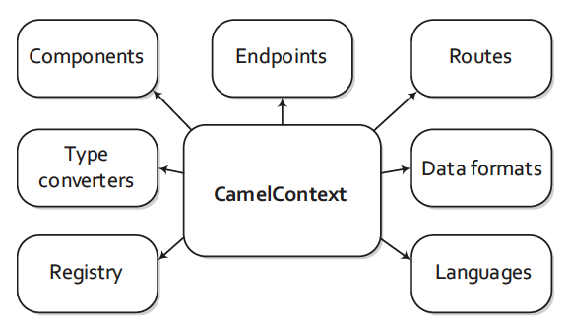
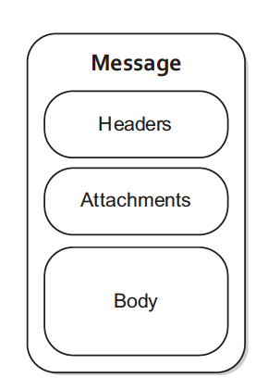
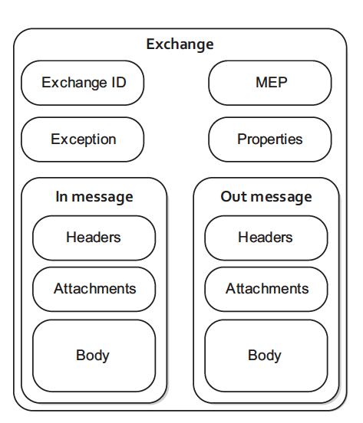
Camel’s Model
Camel Context
org.apache.camel.Message
org.apache.camel.Exchange

Slide 10
Where do I get more information?
Try Camel Examples
http://camel.apache.org/examples.html
Read other blogs and articles
http://camel.apache.org/articles.html
http://stackoverflow.com/questions/tagged/apache-camel
Books
Camel In Action
Online Courses
https://www.pluralsight.com/courses/apache-camel-intro-integration

